Slide 1
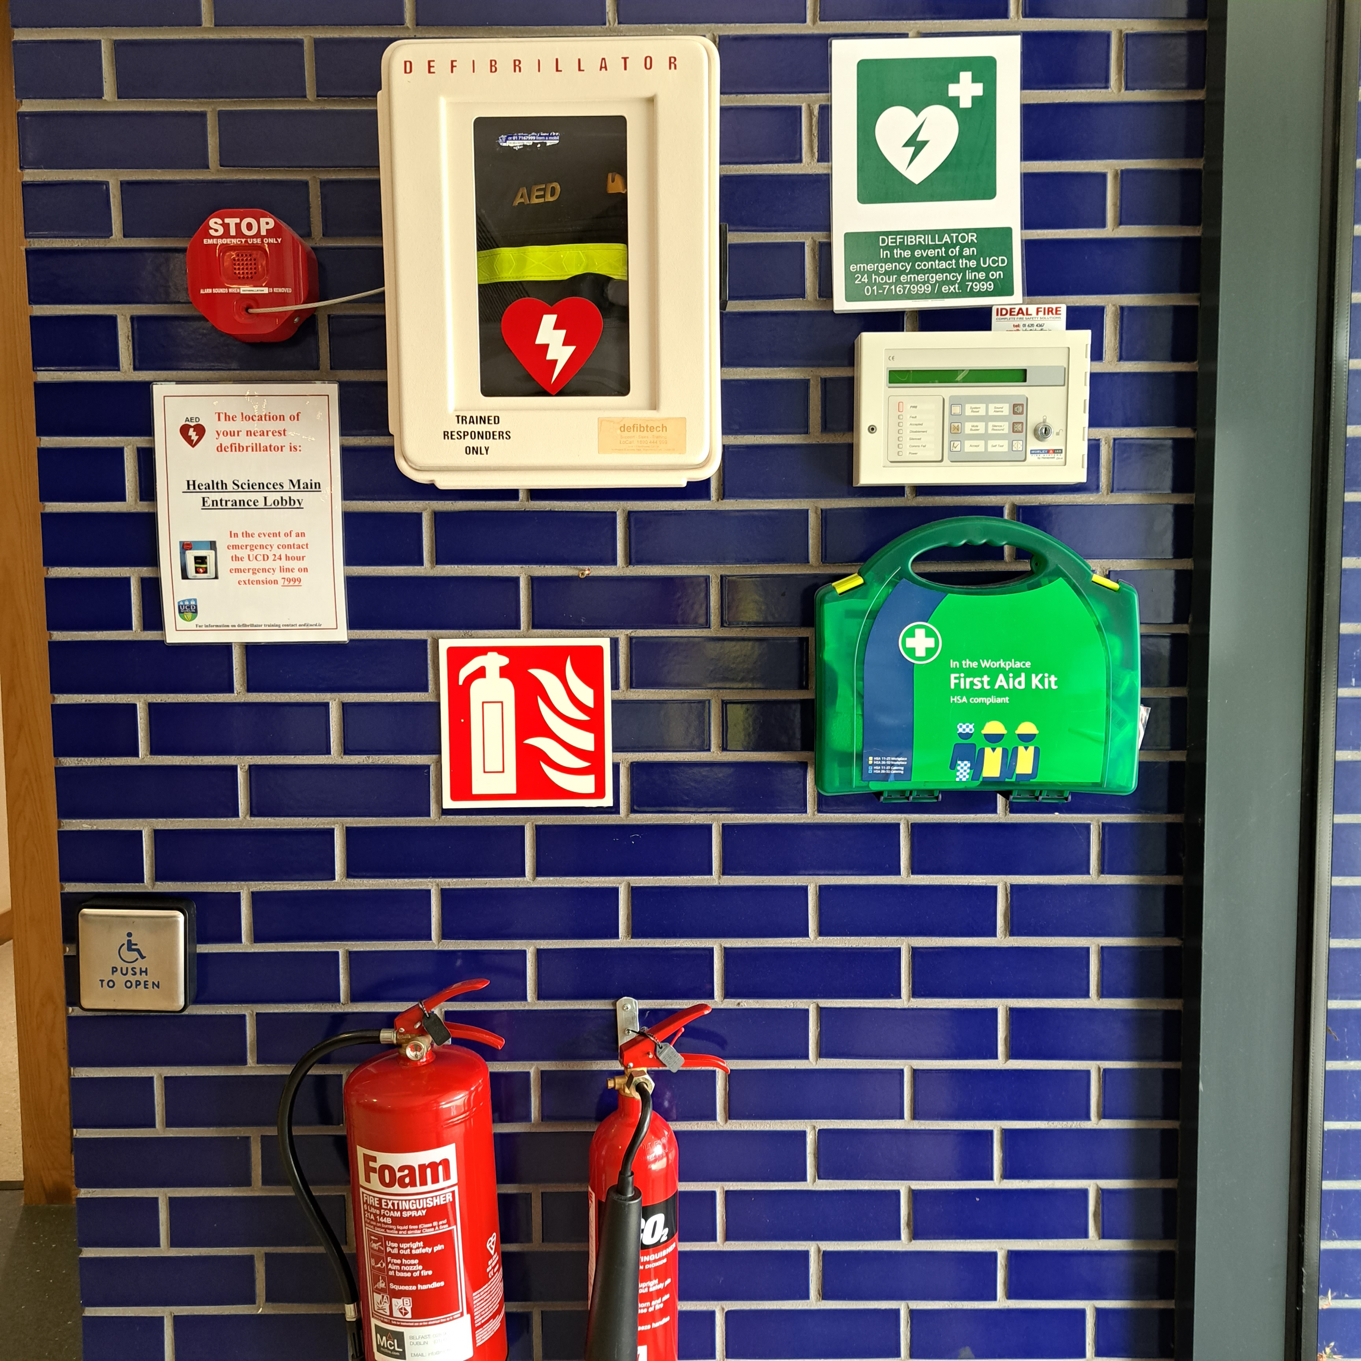
Health Science Centre Safety
The UCD emergency phone number is (00353) 1 716 7999
Safety equipment beside the Main Entrance – Reception area
  First Aid Kit
  AED (defibrillator)
  CO2 fire extinguisher (electrical fires)
  Foam fire extinguisher (flammable solids and liquids)

Slide 2
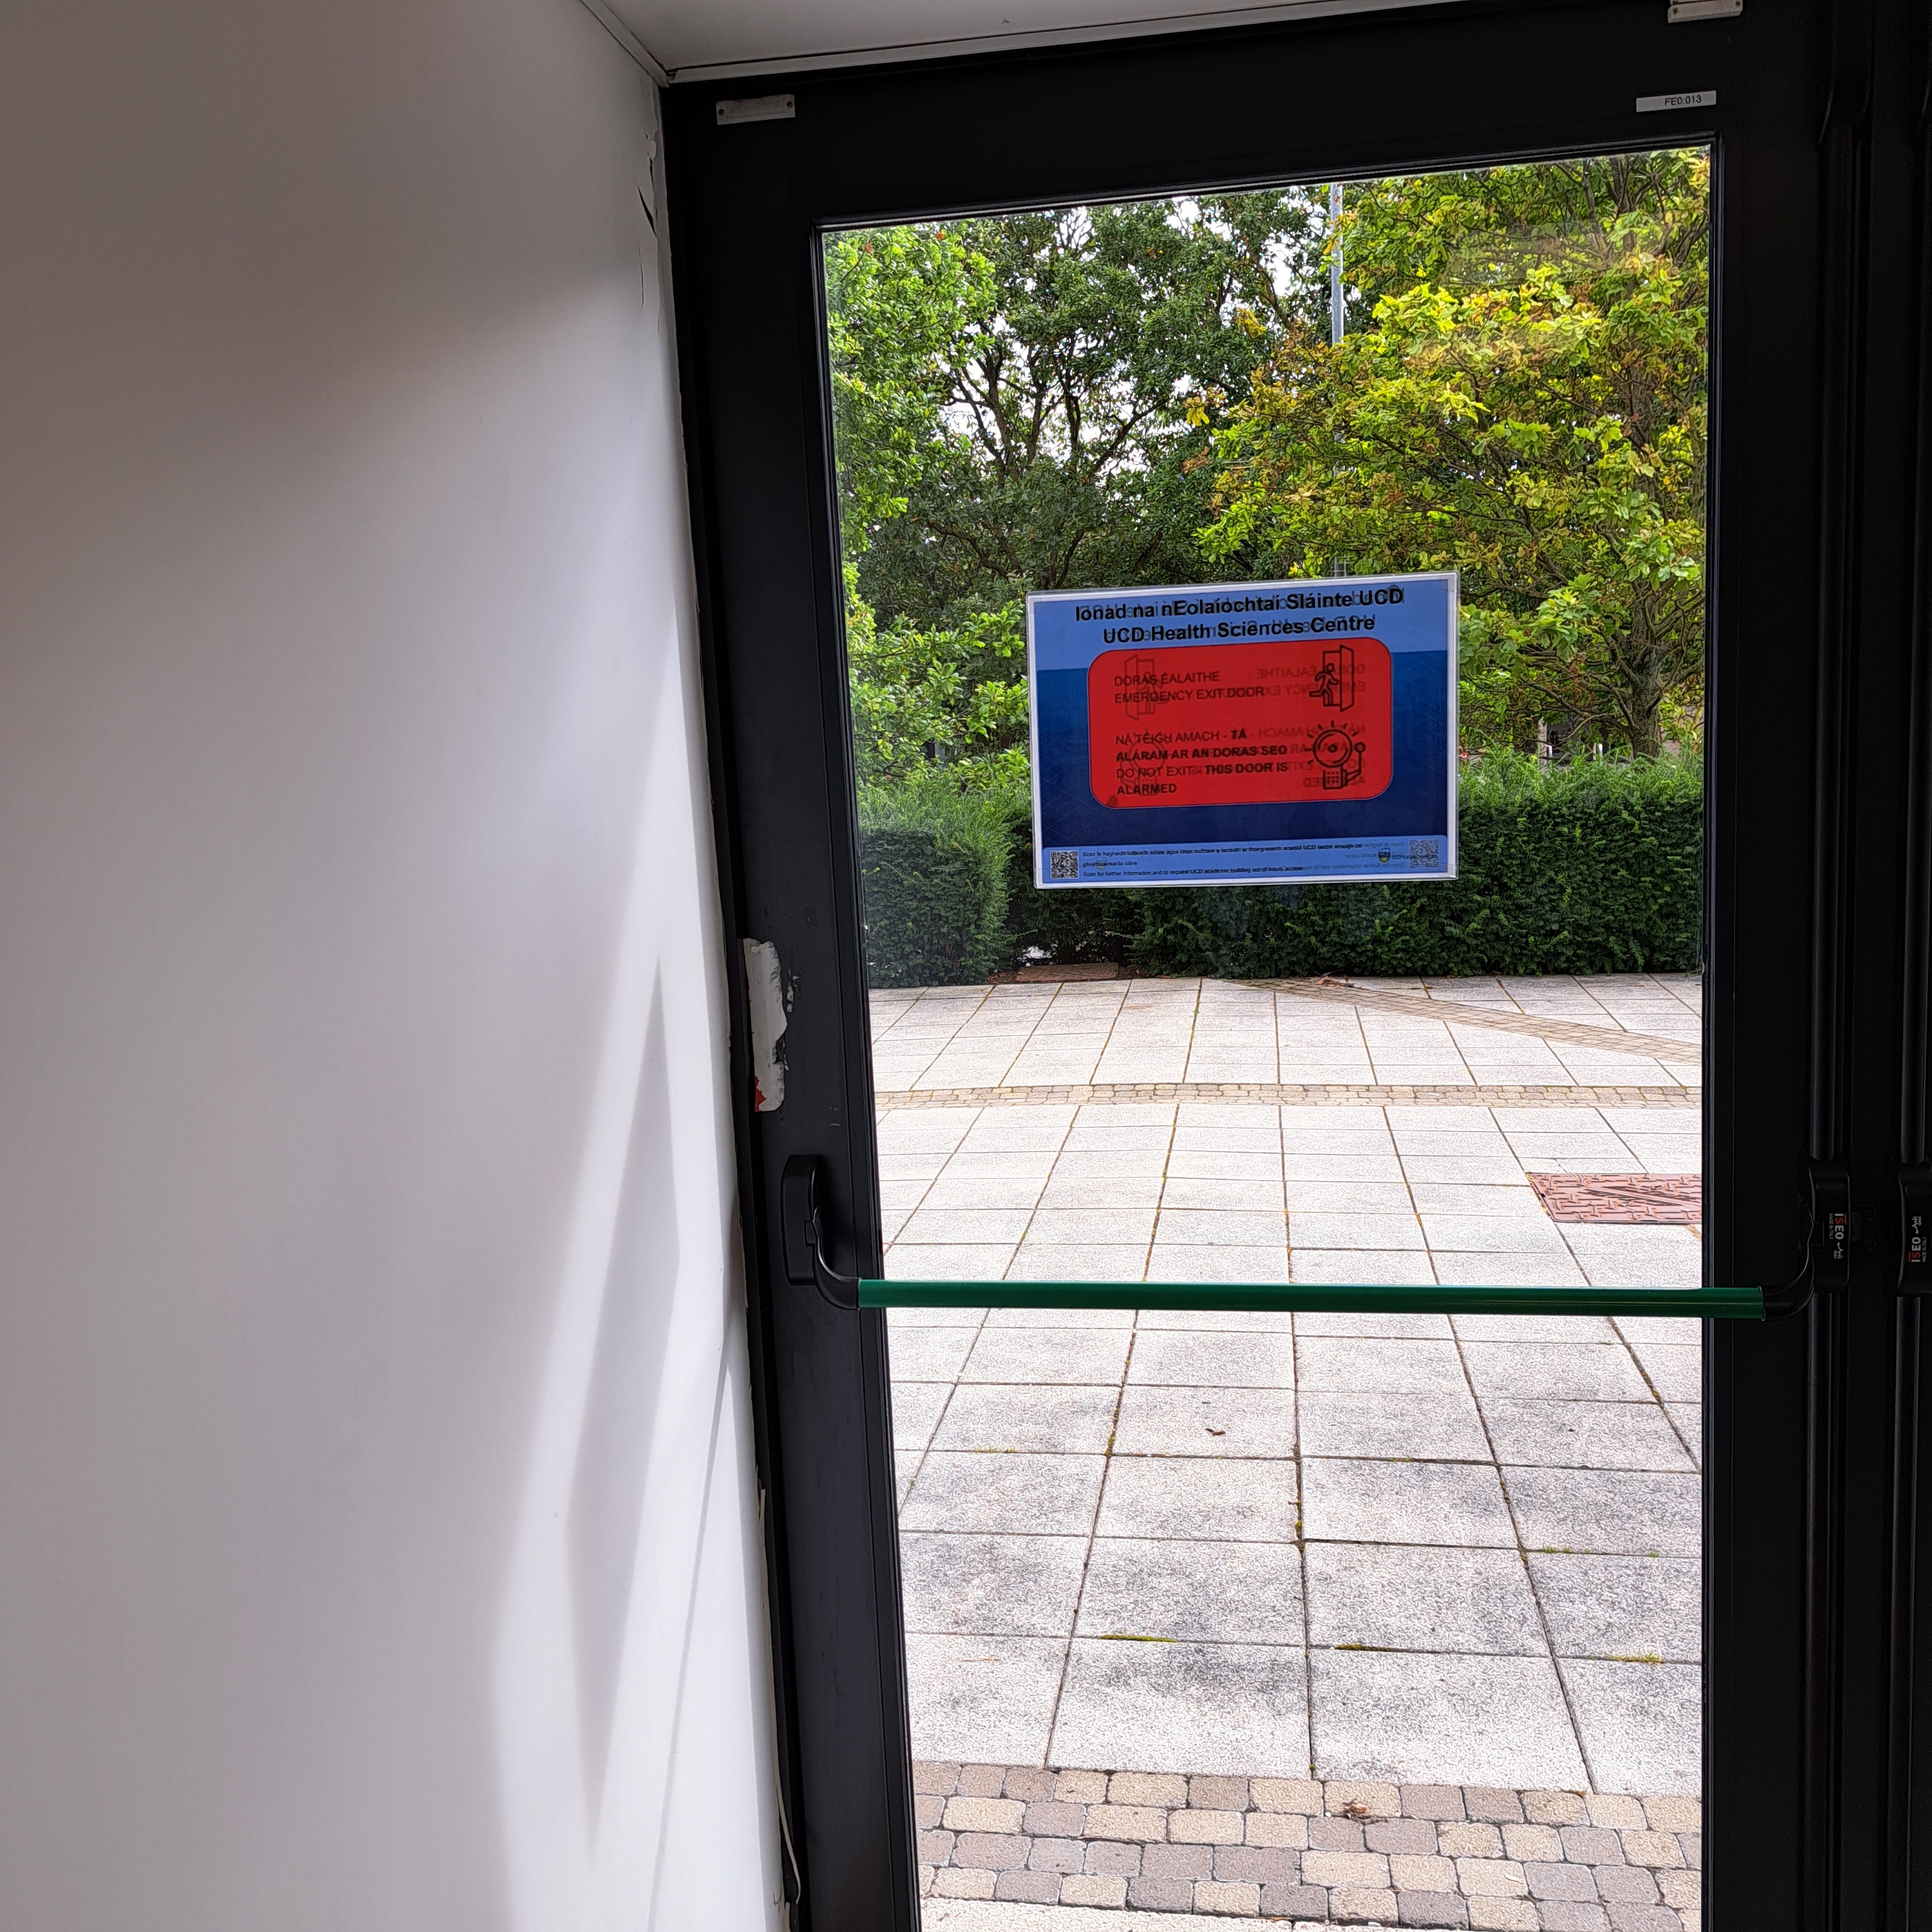
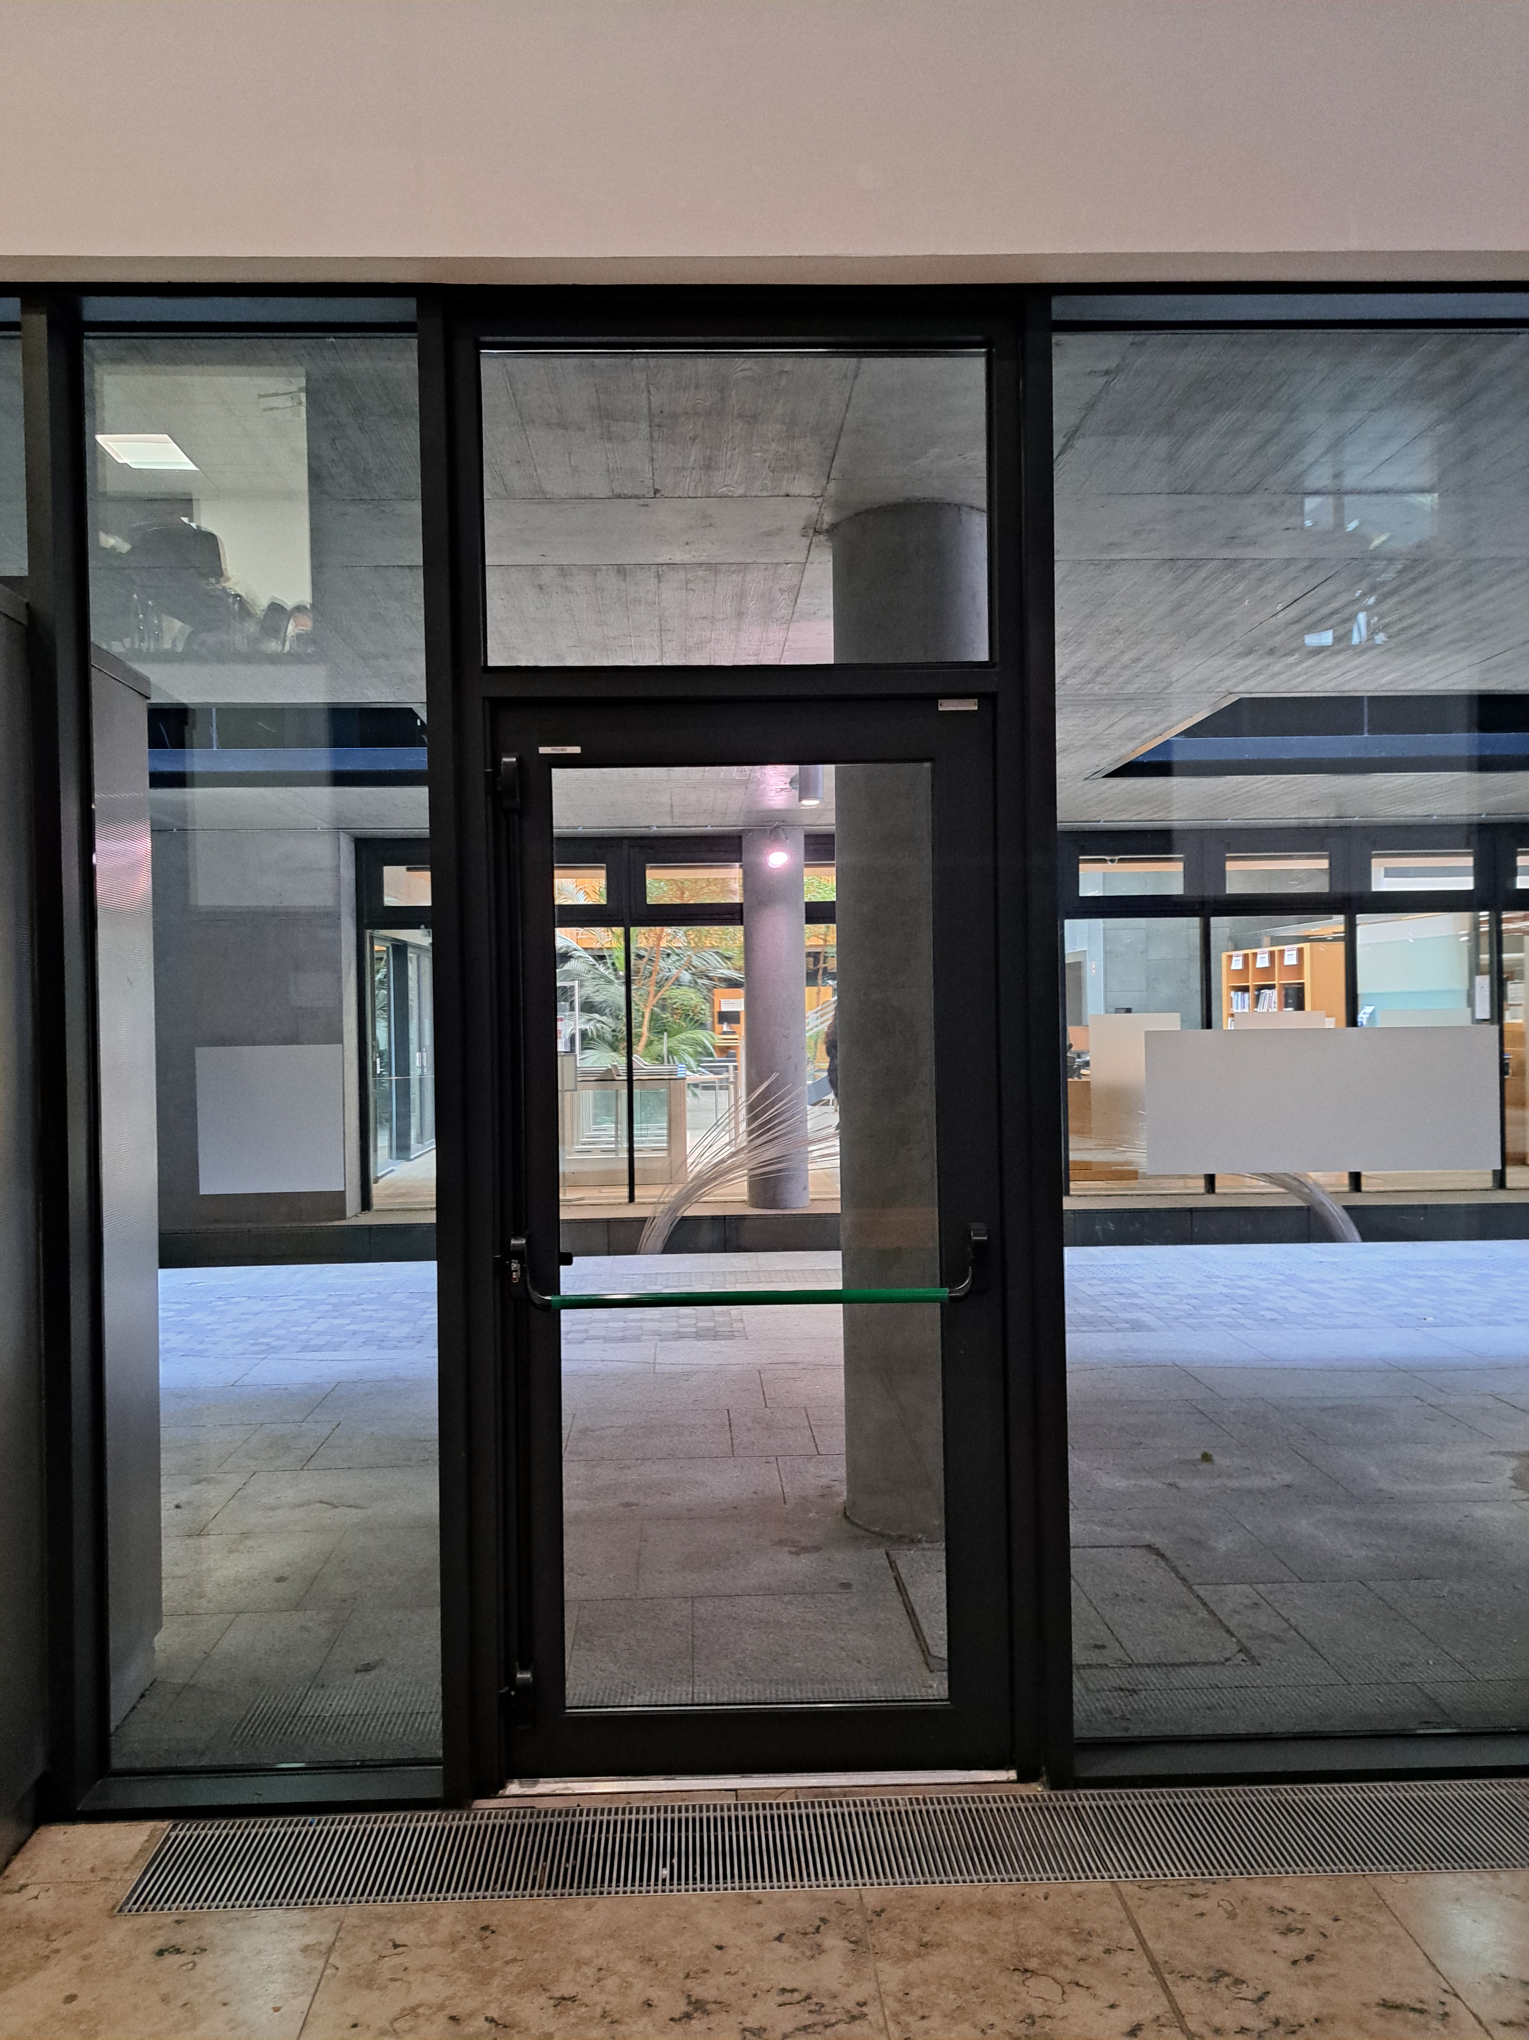
Only use the Emergency Exit Doors in an emergency.
Emergency Exit Door notice
Green-coloured fire door handle
Green coloured fire door handle

Slide 3
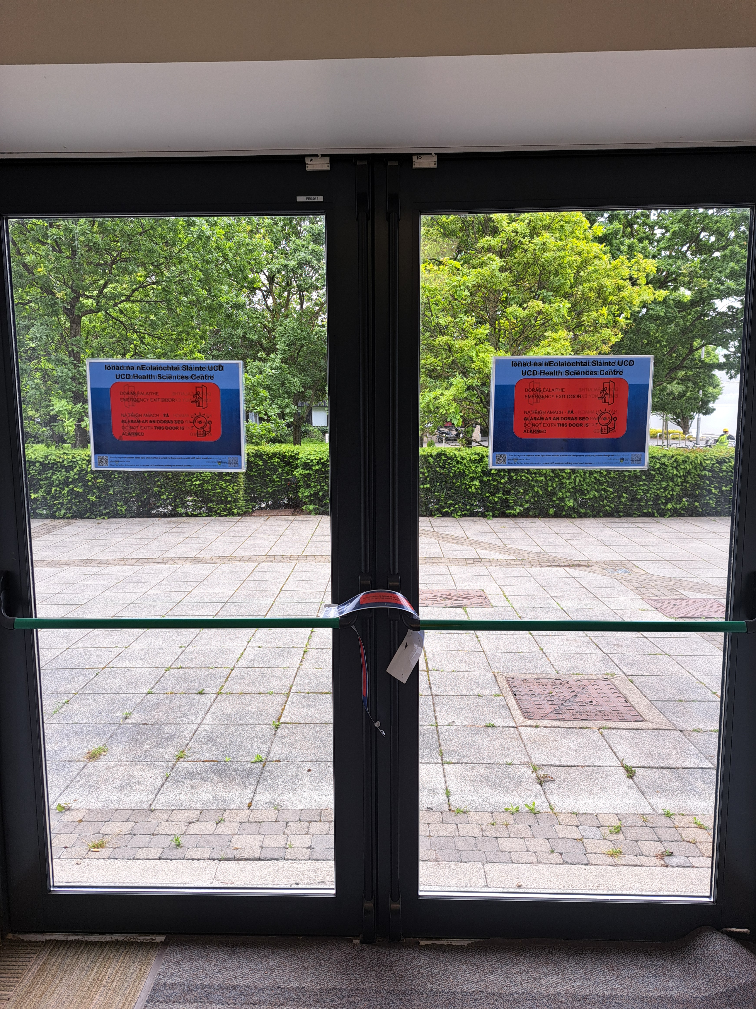
Only use the Emergency Exit Doors in an emergency.
Emergency Exit Door notice
‘This is not a short-cut’ tape
Green coloured fire door handle

